Slide 1
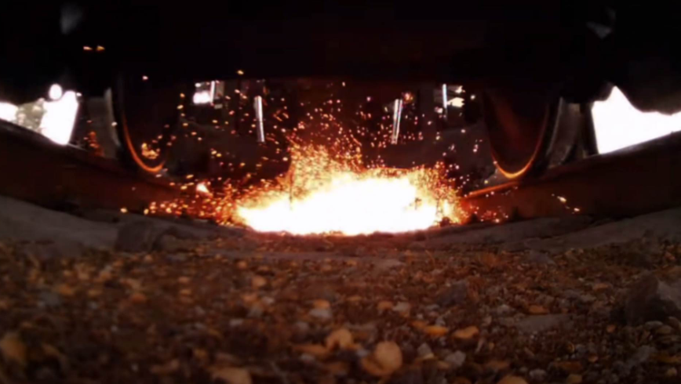

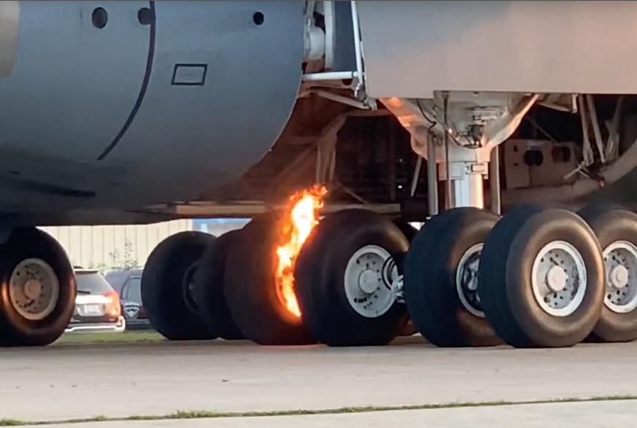
Project: Heat transfer in railway brake system
Yanjun Zhang
PhD student
Vehicle engineering
Teknikringen 8, third floor

Slide 2
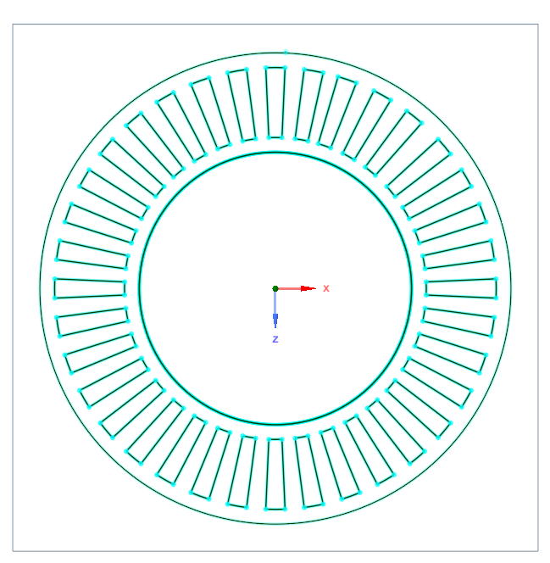
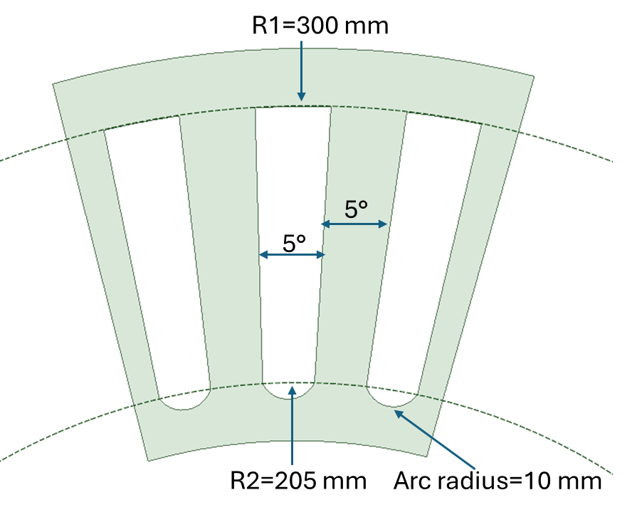
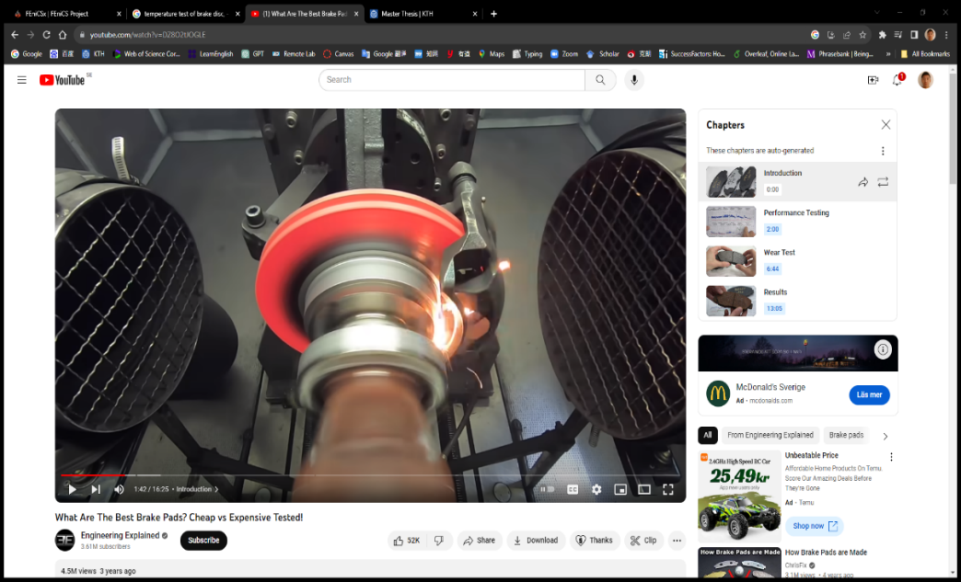
1: Thermal analysis of brake disc
Heat generation
Heat dissipation
Conduction
Convection
Radiation
Aim: calculating the heat transfer coefficient around the cooling fins
Cooling fins

Slide 3
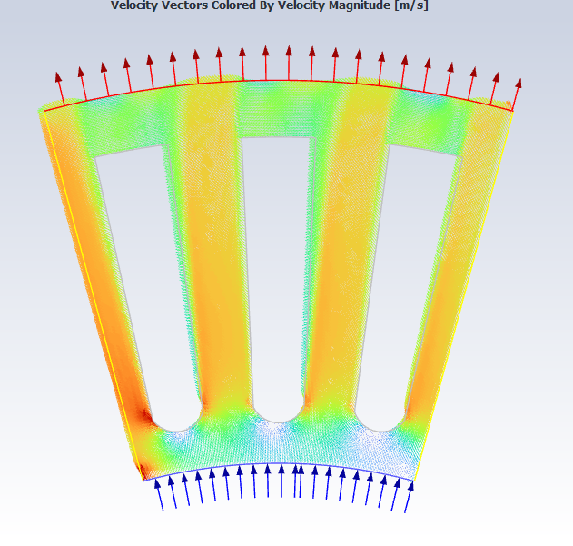
Main task
1: Choose a suitable solver
2: Mesh sensitivity
3: Calculate heat transfer coefficient
4: Design new cooling fins
Rotation
q=h × A × Δt
q: Heat flux around cooling fins, w
h: heat transfer coefficient W/m²
A: area of cooling fin,
ΔT: temperature difference between cooling fin and inlet air

Slide 4
Thanks
Yanjun Zhang
yanjunzh@kth.se

